Slide 1
Lecture 16
Generating Functions

Slide 2
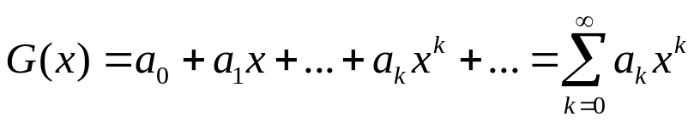
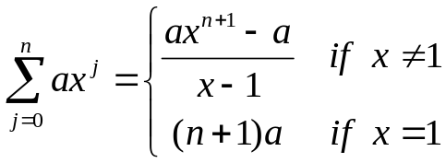
Generating Functions
Basically, generating functions are a tool to solve a wide variety of
counting problems and recurrence relations, find moments of probability distributions
and much more.
The idea is to associate with any sequence {an} a function defined as follows:
- For finite sequences of order n we simply set all terms higher than n to 0.
- Example: G(x) for 1,1,1,1,1 = 1+x+x^2+x^3+x^4+x^5=(x^6-1)/(x-1) (x not 1)
where we used the result:

Slide 3
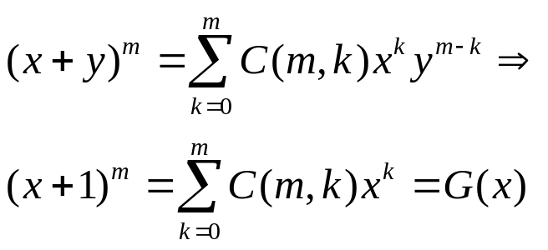
GF
For the binomial coefficients we already know that:
Therefore: (x+1)^m is the generating function for the binomial
coefficients a[1]...a[m] with a[k]=C(m,k).

Slide 4
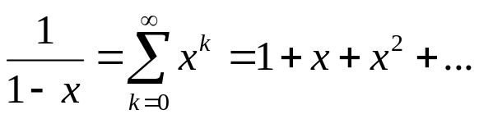
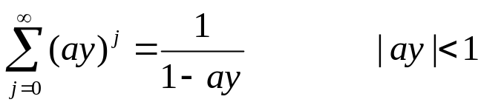
Some Useful G(x)
Take a=1, x<1 and take the limit n→ infinity
Therefore: 1/(1-x) is the generating function for the sequence 1,1,1,1,1,.....
Now write y=(ax)→
Therefore 1/(1-ax) is the generating function of 1, a, a^2, a^3, ...

Slide 5
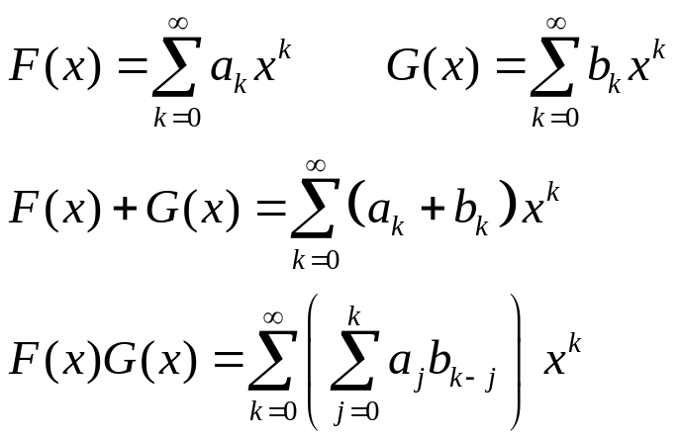
Algebra on G(x)
If we have two generating functions F(x) and G(x), we define the sum
and product as follows:
Match all terms with
equal powers in x.
(a0+a1x+a2x^2)(b0+b1x+b2x^2)=
(a0b0) + (a0b1+a1b0)x + (a0b2+a1b1+a2b1)x^2 + (a1b2+a2b1)x^3 + (a2b2)x^4

Slide 6
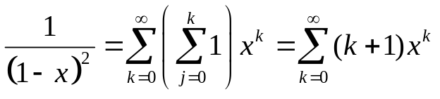
GF
Example why multiplying generating functions is useful:
F(x)=1/(1-x)^2 = 1/(1-x) 1/(1-x)
both have generating functions: 1+x+x^2+...

Slide 7
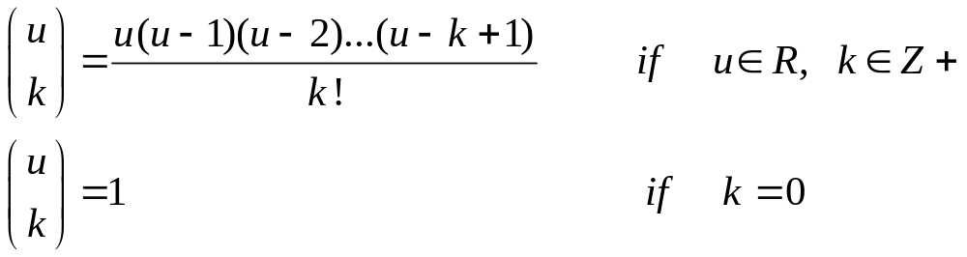
Extended Binomial Coefficients
What is new is that u is now any real number.
Note that for u positive integers, the definition is the same as C(u,k).
Note that: EC(m,k) with k>m we have: m(m-1)(m-2)...(m-m)(m-m-1)...(m-k+1)=0
but this is not true when m is not an integer!
Example: EC(-2,3) = (-2)(-3)(-4) / 3! = -4.
EC(0.5,3)=(0.5)(-0.5)(-1.5) / 3! = 1/16

Slide 8
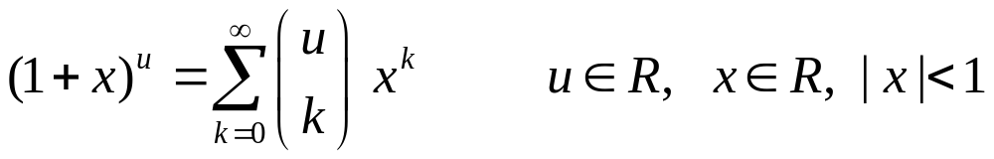
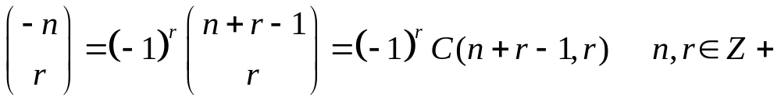
Extended Binomial Theorem
Handy property of extended Binomial coefficients:
notation: () notation is for extended BC, while C() is only for ordinary BC!

